Slide 1

Module 3
Engineering Design
Notes:
45 s
This will be presented during the kick-off meeting 23-27 September 2019
This file is authored by Pierre Dehombreux, Stanislav Hosnedl, Édouard Rivière and is a deliverable of the MUPIC project supported by the European Commission.

Slide 2

Overview of the Engineering Design Module
Part One : Introduction to the Engineering Design Process
A methodology for product design
Part Two : From customer’s needs to specifications
Part Three : State-of-the-art and evaluation of technical solutions
Part Four : Creativity in Engineering Design
Notes:
140 s

Slide 3
Part 1
Introduction to the Engineering Design Process
Notes:
Authors: Pierre Dehombreux (UMONS), Stanislav Hosnedl (UWB), Édouard RIvière-Lorphèvre (UMONS)

Slide 4
Introduction to the Engineering Design Process
You will learn about:
Product life cycle
Design Process as a general problem solving scheme
The main steps of a design process (Clarification – Conceptual design – Product design)
Examples:
Hospital bed – student project at UWB
Airbus A380 (large industrial project)
A remotely operated underwater vehicle (ROV) – student project at UMONS
Schedules and milestones for your project
Notes:
Product life cycle: as many descriptions as authors
According to Prof. Stanislav Hosnedl
Adapted also from ullm2009

Slide 5
The product
A product is defined by ISO9000:2005 as a result of any process, classifed as:
hardware: tangible, material objects, with countable quantity (cars, chocolate bars, shoes, building...)
processed material: solid, liquid, gaseous (bulk) material that can be measured in units of volume, mass, energy, etc... (fuel, wood pellets, ...)
software: intangible objects; information (computer programs, insurance policies, ...)
service: intangible results of an activity (a process) performed as the interface between a supplier and a customer (training, advertising, cleaning, ...)
Notes:
Retrieved from [eder2010]

Slide 6
The product life cycle : global overview
Planning
Engineering design
Process planning
Manufacturing
Distribution
Operation - Use
Decommissioning
Notes:
Product life cycle: as many descriptions as authors
According to Prof. Stanislav Hosnedl
Adapted also from ullm2009
« Methods » has been replaced by « Process planning »

Slide 7
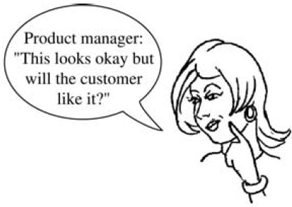
The product life cycle
Planning (main objective for this kick-off)
  Identify needs – Problem clarification
  Plan for the design process (assignments)
Engineering design
Process planning
Manufacturing
Distribution
Operation - Use
Decommissioning
Source for illustration: [ullm2009]
Notes:
According to Prof. Stanislav Hosnedl
Adapted also from ullm2009

Slide 8
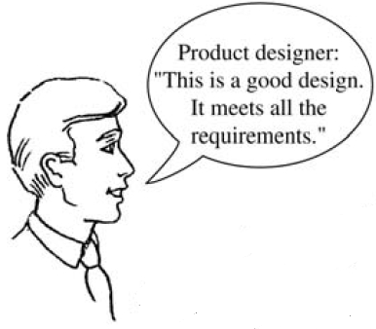
The product life cycle
Planning
Engineering design
  Develop engineering specifications
  Develop concepts
  Develop product
Process planning
Manufacturing
Distribution
Operation - Use
Decommissioning
Source for illustration: [ullm2009]

Slide 9
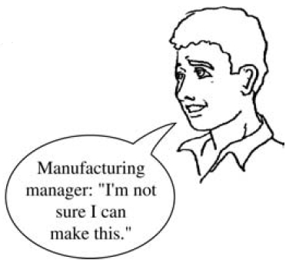
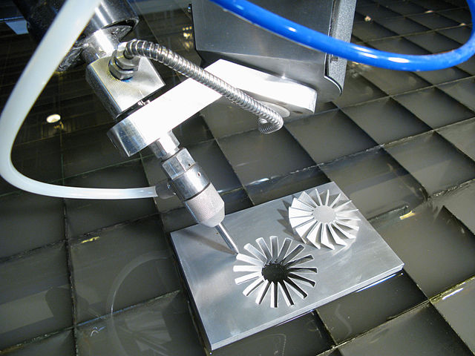
The product life cycle
Planning
Engineering design
Process planning : preparation of manufacturing
(determination of manufacturing methods, tools,
fixtures; manufacturing times, sequence for assembly,
cost estimation, ...)
Manufacturing
Distribution
Operation - Use
Decommissioning
Notes:
According to Prof. Stanislav Hosnedl
Adapted also from ullm2009 (Fig. 1.7)
Note: concurrent design for integrated product and process design and development [magr1997]

Slide 10
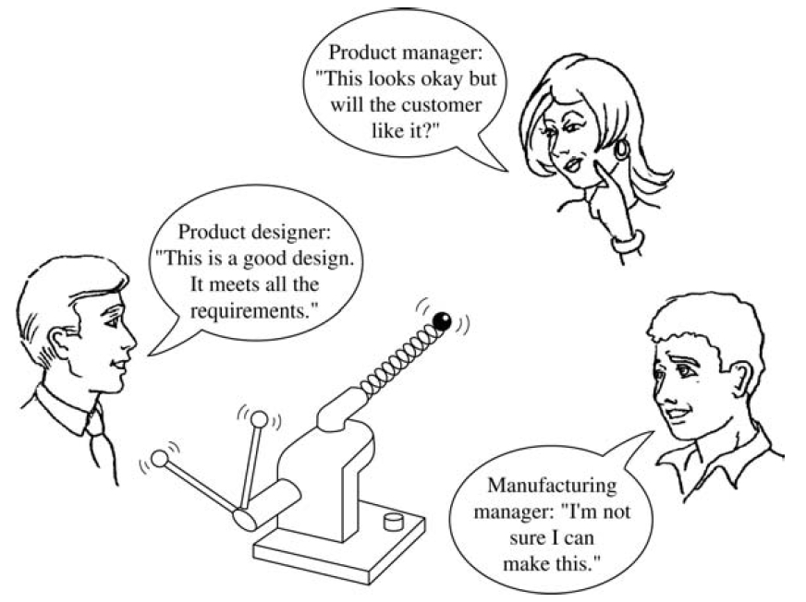
The product life cycle
Importance of collaborative approach
during the design stage:
multidisciplinary teams
Do not forget the voice of the stakeholders!
(Identify them)
Notes:
According to Prof. Stanislav Hosnedl
Adapted also from ullm2009 (Fig. 1.7)

Slide 11
The product life cycle
Planning
Engineering design
Process planning
Manufacturing and Assembly (Production)
Distribution
Operation - Use
Decommissioning
Notes:
According to Prof. Stanislav Hosnedl
Adapted also from ullm2009

Slide 12
The product life cycle
Planning
Engineering design
Process planning
Manufacturing
Distribution and Installation
Operation - Use
Decommissioning
Notes:
According to Prof. Stanislav Hosnedl
Adapted also from ullm2009

Slide 13
The product life cycle
Planning
Engineering design
Process planning
Manufacturing
Distribution
Operation – Use – Maintenance (Reliability, Safety,
Diagnosis, Repair / Replacement , Improvement)
Decommissioning
Notes:
According to Prof. Stanislav Hosnedl
Adapted also from ullm2009

Slide 14
The product life cycle
Planning
Engineering design
Process planning
Manufacturing
Distribution
Operation - Use
Decommissioning : removing from service : end-of-life management
(Retire – Dispose - Disassemble – Recycle - Reuse)
Notes:
According to Prof. Stanislav Hosnedl
Adapted also from ullm2009.
Decommissioning may be seen as an unappropriate term: itis use is frequent for aircrafts, oil platforms, nuclear
Retired: Asset is no longer is use but not disposed.
Disposed: Asset is no longer associated with the company.

Slide 15
The product life cycle
Planning
Design
Operation
Decommissioning
Process planning
Manufacturing
Distribution
Notes:
Product life cycle: as many descriptions as authors.

Slide 16
The product life cycle
Planning
Design
Operation
Decommissioning
Process planning
Manufacturing
Distribution
Prototyping - Tests
Check -Validation
Notes:
These validations are known as the V-Cycle.
.

Slide 17
The product life cycle from the point of view of the designer
Exhilaration
Reward of those who have not done anything
Punishment of the innocents
Anxiety
Search for the guilty
This only occurs for real industrial projects not in MUPIC !
Planning
Panic
Problems arise
Design
Miracle happens
Operation
Decommissioning
Process planning
Manufacturing
Distribution
Prototyping - Tests
Check -Validation
Notes:
Product life cycle: as many descriptions as authors.

Slide 18

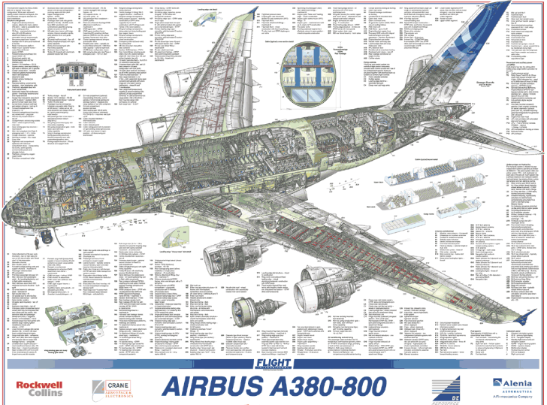


The design process
(example of Airbus A380)
Properties Specifications
Requirements
Conceptual Design
Product Design – Detailed Design
Needs identification
Airplane for long-range activity with significantly increased number of passengers
555 passengers
Mach 0,85
space requirement: in 80x80 m square
range of 14800 km
APU 2x120kVA
less than 2,9 l fuel per passenger per 100 km
Get a strategic advantage over Boeing company
Checkpoint 3 End March
Final presentation
Mid May
Checkpoint 1
Early November
Checkpoint 2 December
Notes:
Auxiliary Power Unit (APU)
[https://simpleflying.com/the-boeing-777x-vs-the-airbus-a380-what-plane-wins/
[27 minutes for the 17 first slides]
an A380 is made up of about four million individual parts produced by 1,500 companies from 30 countries around the world

Slide 19
Funny facts about A380
Decommissioning
Planning
Operation
Design
Distribution
Process planning
Manufacturing
1990 : official announement
December 2000 : project launched
(€9.5 billion)
October 2007 : first delivery
and commercial flight
October 2019 : discontinuation annouced
1988 : first studies
April 2005 :
first flight
2021 :
production stop (290 aircrafts)
January 2005 : first prototype
December 2006 : certification FAA
Market analysis
Industrial Design
Timeline
Economical model, financial aspects, ...
Notes:
[https://simpleflying.com/the-boeing-777x-vs-the-airbus-a380-what-plane-wins/

Slide 20
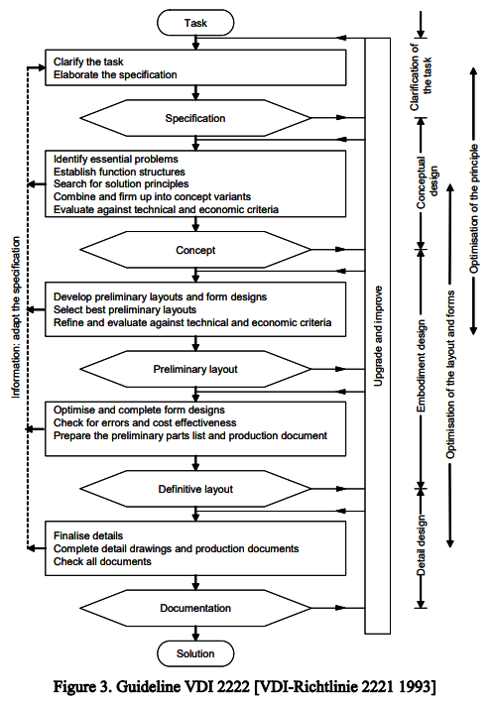
There are as many descriptions of design processes as the number of designers...
Needs Identification
but most are based on the same problem solving scheme and the same quality principle :
« Plan / Do / Check / Act »
applied in an iterative way in a
« continuous improvement loop »
Functional specifications
Conceptual Design
Product Design
Final Elaboration
Notes:
Final Elaboration better than « Detailed Design » because the project is not only a « machine design » project: market analysis, communicaton,, ....
Verein Deutscher Ingenieure

Slide 21
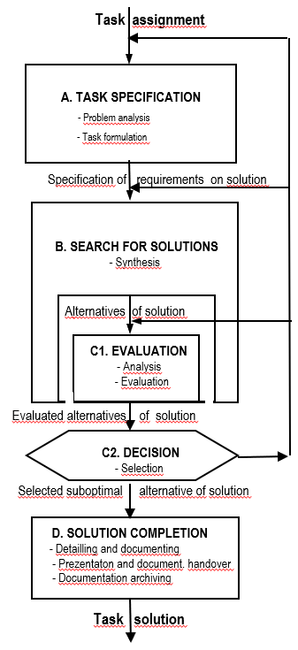
The problem solving scheme
Problem specification
PLAN
Search for Solutions
DO
Needs Identification
Functional specifications
CHECK
Evaluation
Conceptual Design
Decision
ACT
Product Design
Solution completion
Final Elaboration
Documenting
is a quality principle
Notes:
Courtesy of Prof. Stanislav Hosnedl (suggestion: replace Task by Problem)
Project management: initiating, planning, executing, closing + monitoring & controlling

Slide 22
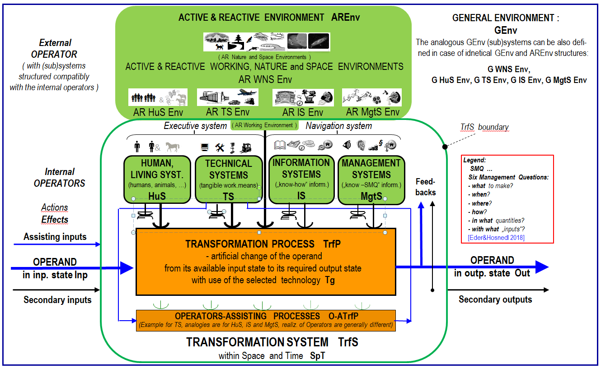
Technical system
Consider it in interaction with its environment.
Consider it in relation with the information systems world
(you are the 4.0 generation!) and
with the real life world (management)
Notes:
This image is copyrighted. It is presented here as a courtesy of Prof. Stanislav Hosnedl

Slide 23
Timeline of a design process :
Elaboration of the problem
Parts 2 and 3 will help respectively for
Functional / Properties specifications
and
State-of-the Art
Identification of the customer’s needs
and other life cycle constraints
Problem clarification
Establishing functional specifications
and other product properties
Search for the State-of-the-Art
Establishing project solution plan
  - Solution strategy
  - Project solution timetable
Needs Identification
Functional specifications
Conceptual Design
Module on Project Management will help for Project solution plan
Product Design
Final Elaboration
Notes:
Ullm1997 99, 100
Clarification with Stan: distinction between Specifications and Requirements?

Slide 24
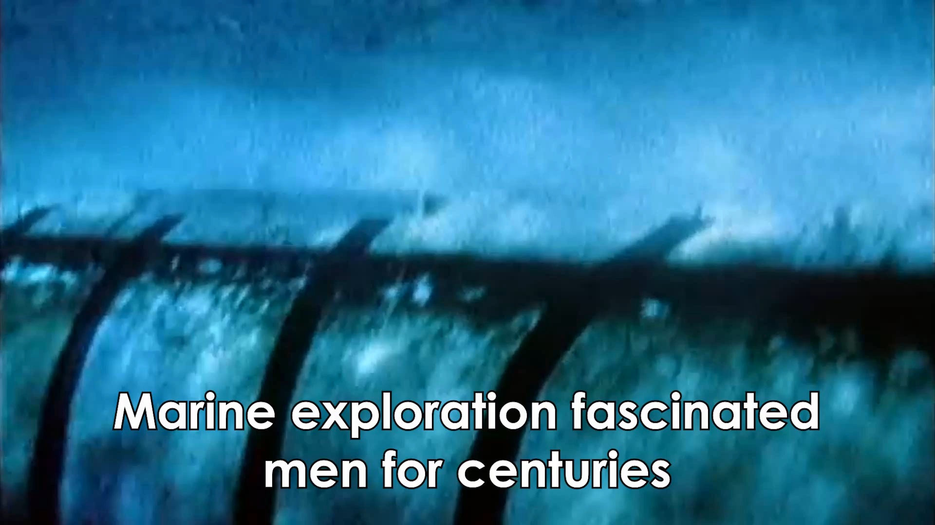
Partial Illustration of the Design Process
Remotely Operated Vehicle (ROV) Submarine
Identification of the customer’s needs
and other life cycle constraints
Needs Identification
Global vague ideas
Unstructured wishes
Dreams
Functional specifications
Conceptual Design
Product Design
Final Elaboration
Notes:
Submarine_Elaboration.mp4

Slide 25
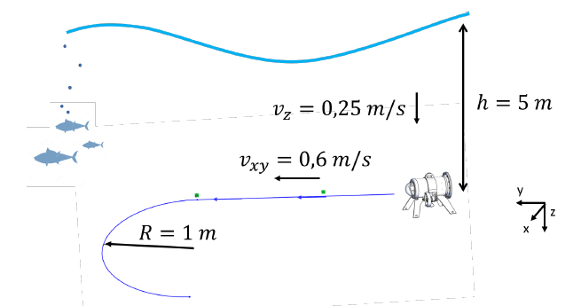
Partial Illustration of the Design Process
Remotely Operated Vehicle (ROV) Submarine
Establishing functional specifications
and other product properties
Needs Identification
Remotely operated through ombilical wire
Real time video
Maximal depth : 5 m
Maximal horizontal speed : 0,6 m/s
2 hours of normal operation
Dimensions max. : 400 m x 200 mm x 150 mm
Maximal weight : 3 kg
Do It Yourself approach (manufactured and assembled in a local FabLab)
Functional specifications
Conceptual Design
Product Design
Final Elaboration

Slide 26
To clarify requirements, specifications, properties, constraints, ...
Consider each stage of the Life Cycle (LC)
Describe the process by adopting different points of view
- Hospital bed, patient, healthcare, nurse
- Conveyor, plastic part, material handling, operator, moulding unit, ...
- Bumper, unfortunate pedestrian, collision safety, wattman, ...
- Operator, operand, process, ...
This will identify the functions that are expected
Notes:
This image is copyrighted. It is presented here as a courtesy of Prof. Stanislav Hosnedl

Slide 27
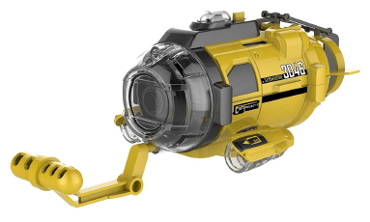
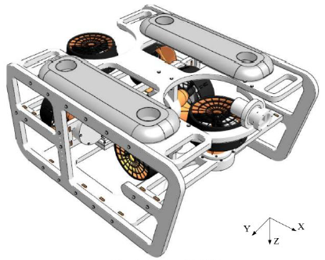
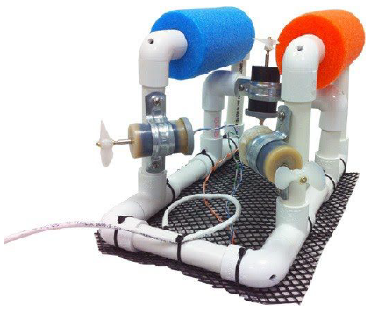
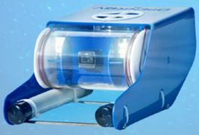
Partial Illustration of the Design Process
Remotely Operated Vehicle (ROV) Submarine
Search for the State-of-the-Art
Needs Identification
Functional specifications
Conceptual Design
Product Design
Final Elaboration
Classification
Identification of features (functions are satisfied by different means)

Slide 28
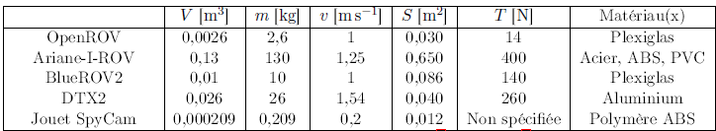
Partial Illustration of the Design Process
Remotely Operated Vehicle (ROV) Submarine
Search for the State-of-the-Art
Needs Identification
Comparison table
Functional specifications
Conceptual Design
Feature comparison chart
Market Analysis
SWOT
Strengths
Weaknesses
Opportunities
Threats
Product Design
Power
D
E
Final Elaboration
B
C
We would like to be here
A
Weigth

Slide 29
Timeline of a design process :
Needs assesment and problem clarification
Checkpoint 1
November
Needs Identification
Milestone | Project Management | Communication - Intercultural | Business - Marketing | Industrial Design - Art | Engineering Design
Check Point 1 | Plan of progress - vision - preliminary definition of additive demands and supply to our project | Diary reflection on communication and intercultural aspects in virtual teams: cultural identity Media Synchronicity Theory | Stakeholders identification Market research - setting economic targets - market analysis with a focus on competitive or related products | Design study - competitive - expected | Elaboration the problem State-of-the-art (partial) (SWOT of competitive products, analysis of patents, ...) Potential innovation space Requirements specifications
Functional specifications
Conceptual Design
Product Design
Final Elaboration
Notes:
[Updated on September 21, 2019 according to the common MUPIC Matrix]

Slide 30
Timeline of a design process :
Conceptual Product Design of the Technical System
Needs Identification
Express functions
Kinematic architecture
Industrial design - Art
Functions lead to selection of components
(General rule: one function - one component)
First sketches and drawings
Functional specifications
Conceptual Design
Product Design
Final Elaboration
Notes:
Ullm1997 99, 100
Clarification with Stan: distinction between Specifications and Requirements?

Slide 31

Partial Illustration of the Design Process
Remotely Operated Vehicle (ROV) Submarine
Needs Identification
Functional specifications
Conceptual Design
Product Design
Final Elaboration
Notes:
MUPIC_ConceptualDesign.mp4

Slide 32
Timeline of a design process :
Conceptual Product Design of the Technical System
Checkpoint 2 December
Milestone | Project Management | Communication - Intercultural | Business - Marketing | Industrial Design - Art | Engineering Design
Check Point 2 | Layout of the project work load optimization progress expectation (intermediate report) | Diary reflection on communication and intercultural aspects in virtual teams: communicative styles trust and conflict management | Adding product requirements based in the « market » analysis (Must have – Should have – Could have – Won’t have) PESTEL analysis (intermediate report) | Concept Draft Design Sketch Rough concept of the presentation of project (intermediate report) | State-of-the-art (final) Conceptual Product Design (incl. Design alternatives, their SWOT evaluation and decision,(prediction of properties and performance is an inherent introductory part of the SWOT evaluation and decision) (intermediate report)
Needs Identification
Functional specifications
Conceptual Design
Product Design
Final Elaboration
Notes:
PESTEL : Political, Economical, Social, Technological, Environmental, Legal

Slide 33
Timeline of a design process :
Product Design of the Technical System
Needs Identification
Iterative design procedure carried out in accordance to quality and competitive principles to reach a detail design where parts have been properly defined and embodied in a system, with manufacturing, assembly, cost, environmental and other relevant constraints that ought to be taken into account over the whole life cycle.
Continuous evaluation of the suitability of the (predicted) product functions and other properties comparing to the specified requirements and competitive products
Functional specifications
Conceptual Design
Product Design
Final Elaboration
Notes:
Ullm1997 99, 100
Clarification with Stan: distinction between Specifications and Requirements?

Slide 34
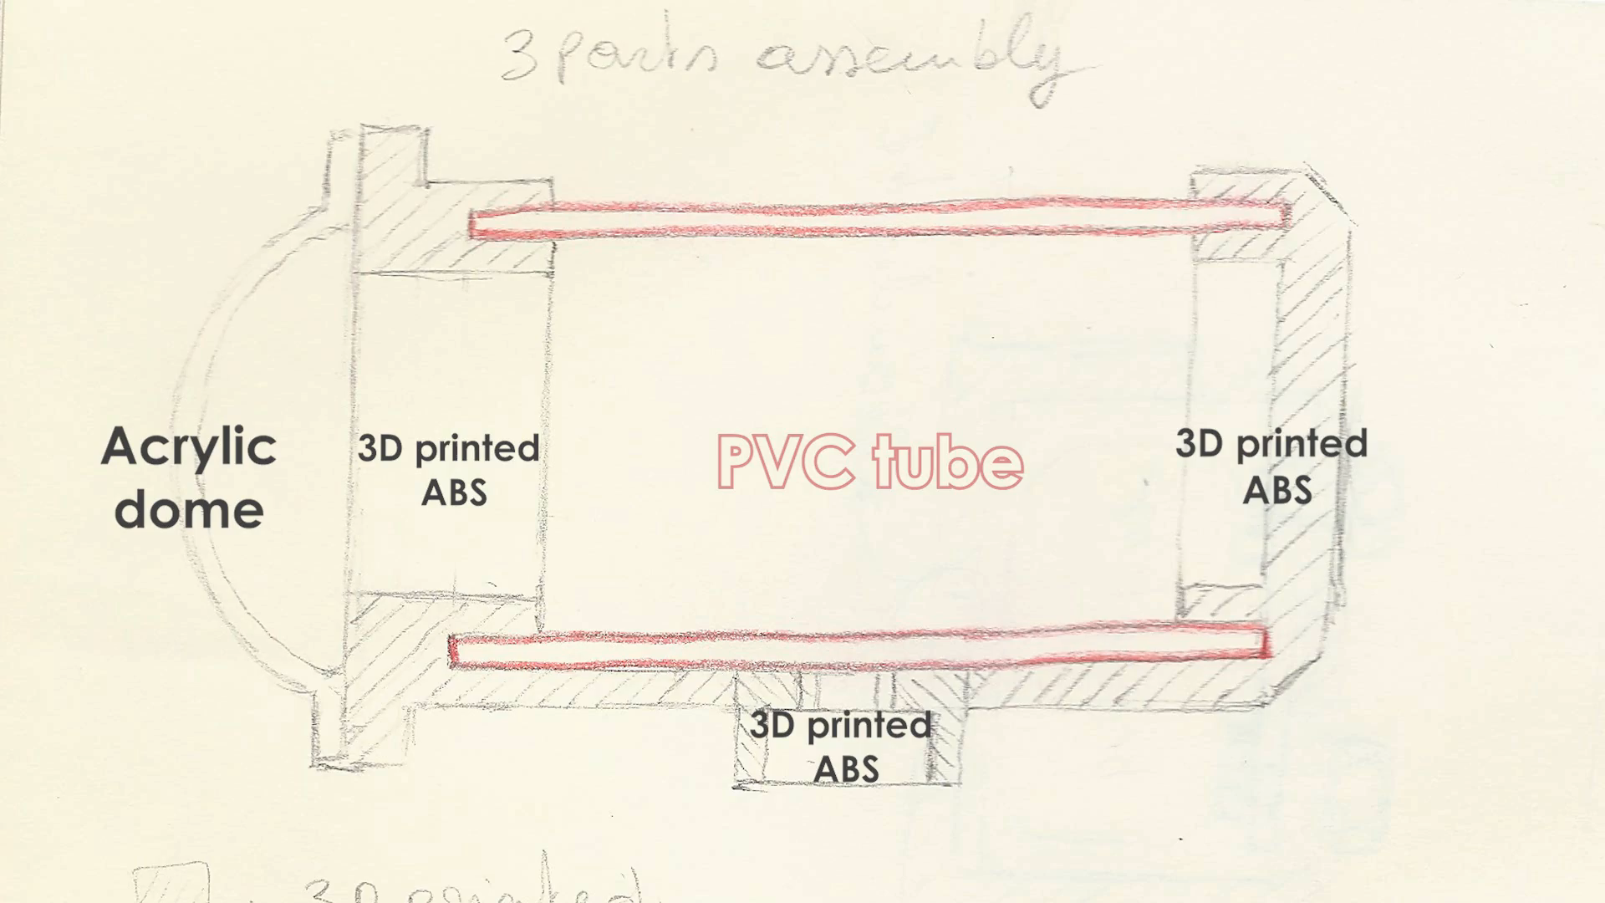
Partial Illustration of the Design Process
Remotely Operated Vehicle (ROV) Submarine
Needs Identification
Functional specifications
Conceptual Design
Product Design
Final Elaboration
Notes:
MUPICDetailDesign

Slide 35
Timeline of a design process :
Conceptual Product Design of the Technical System
Checkpoint 3 March
Milestone | Project Management | Communication - Intercultural | Business - Marketing | Industrial Design - Art | Engineering Design
Check Point 2 | Etablish proper work progress Design complete control structure and establish exact communication channels | Diary reflection on communication and intercultural aspects in virtual teams: netiquette and ethical aspects | Cost evaluation Quality prediction | Consensus concept with construction and economical optimization for the preliminary layout | Constructional Product Design “1st iteration” Innovation proposals based on the suboptimal conceptual alternatives SWOT evaluation of the 1st draft proposal (update of the prediction of properties and performance)
Needs Identification
Functional specifications
Conceptual Design
Product Design
Final Elaboration

Slide 36
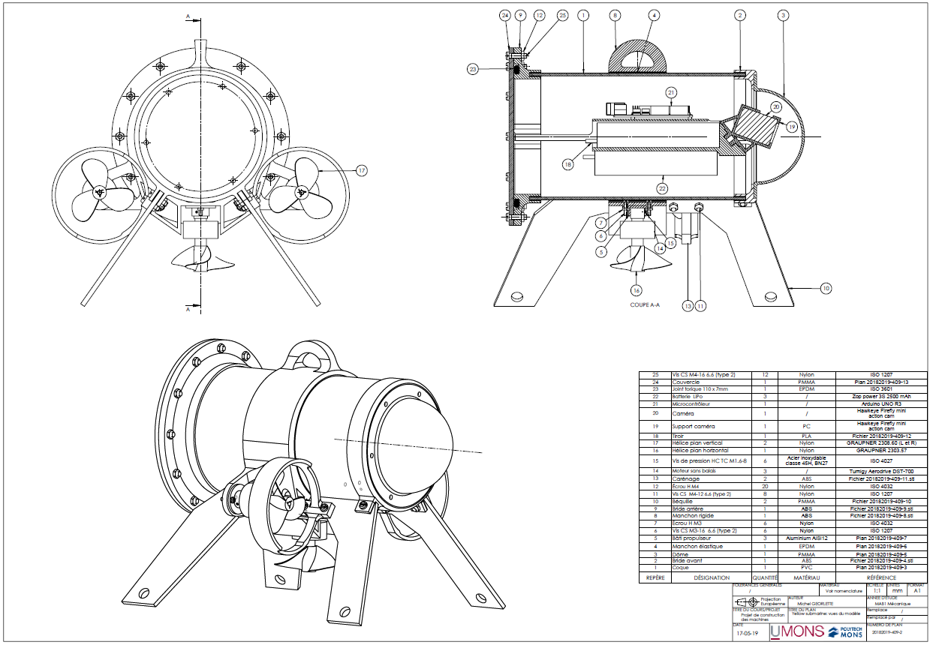
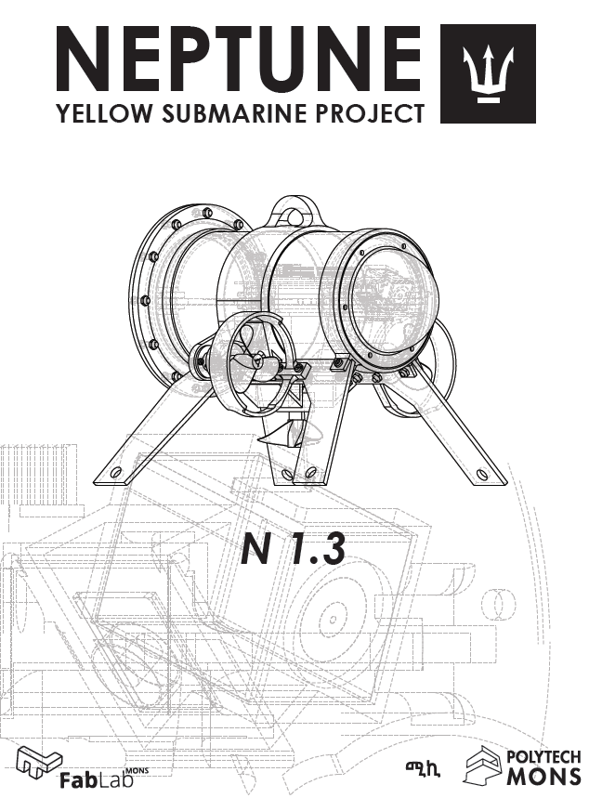
Partial Illustration of the Design Process
Remotely Operated Vehicle (ROV) Submarine
Needs Identification
Functional specifications
Conceptual Design
Product Design
Final Elaboration

Slide 37

Partial Illustration of the Design Process
Remotely Operated Vehicle (ROV) Submarine
Needs Identification
Prototyping (manufacturing and assembly)
Tests (on components and prototype)
Documentation and communication
See the full video on
Functional specifications
Conceptual Design
Product Design
Final Elaboration

Slide 38
Timeline of a design process :
Conceptual Product Design of the Technical System
Final Presentation May
Needs Identification
Milestone | Project Management | Communication - Intercultural | Business - Marketing | Industrial Design - Art | Engineering Design
Final presentation in front of the customers | Evaluation of results Evaluating and conclusion Suggestion for improvements | Evaluation of reflections/learning Setting new individual learning objectives | Reflecting of benefits Marketing proposal Product cost definition | Visualization and final design based on final proposals | Detail Product Design “Second iteration”: definitive (dimensional) layout (including SWOT evaluation) Completed design project documentation Technical report including CAD models and drawings
Functional specifications
Conceptual Design
Product Design
Final Elaboration

Slide 39
Contacts
If you have comments or questions about this presentation, feel free to contact by email:
Prof. Pierre Dehombreux (UMONS), pierre.dehombreux@umons.ac.be
Dr. Lucas Equeter (UMONS), lucas.equeter@umons.ac.be
Thank you for your attention
Thanks for UWB and Prof. Stanislav Hosnedl and his team

Slide 40
References
[eder2010] Eder, W. Ernst and Hosnedl Stanislav (University of West Bohemia) Hosnedl. 2010. Introduction to Design Engineering. Boca Raton: CRC
[magr1997] Magrab, Edward B. 1997. Integrated Product and Process Design and Development. The Product Realization Process. CRC Press.
[pahl1996] Pahl, Gerhard and Wolfgang Beitz. 1996. Engineering Design. A Systematic Approach. 2nd ed. London: Springer.
[samu1999] Samuel, Andrew, and John Weir. 1999. Introduction to Engineering Design - Modelling, Synthesis and Problem Solving Strategies. Butterworth Heinemann.
[ullm2009] Ullman, David G. 2009. The Mechanical Design Process. 4th ed. McGraw-Hill.
[vola1999] Voland, Gerard. 1999. Engineering by Design. 1st ed. Addison-Wesley.

Slide 41
Additional material
Additional material
Notes:
Additional material : not to be presented in front of the students but useful information.

Slide 42
Activity
Discuss the following question:
What makes a mechanical design project different than a software development project?
Think about different aspects (project management, design/development, validation, improvement, team management, documentation, ...)

Slide 43

Operators, Operands, Processes
An operator transforms inanimate materials (M), energy (E), information (I), living material (L)
The operator can be a human, an information system, a management system and of course the technical object, that is the product under development. This technical system will interact with operands and is used in different processes.
For example: an hospital bed for intensive care is a technical system (TS) and must be considered as the operator: the operand will be the patient and the process could be a X-Ray examination (that will need additional properties such as an access to upper/lower body parts).
Notes:
Accordind to [eder2010]

Slide 44
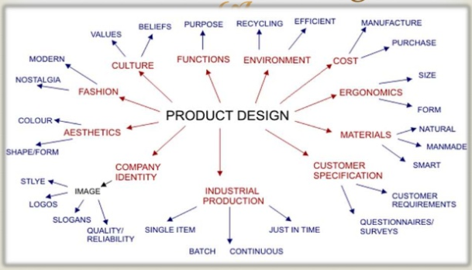
from Daniel M. Sta.Maria MTE 507
Notes:
from Daniel M. Sta.Maria MTE 507

