Slide 1

Module 1
Effective Intercultural Communication in Multicultural Teams
Introduction 5 October 2020
Pia Lindgren, Senior Lecturer

Slide 2

KEY QUESTION TO THINK ABOUT
What are some of the key features of communication style in your culture in social and work situations?
Some more questions in detail..

Slide 3

Communication style
Do you get to the point directly or circle around the topic?
Do you criticize or try to save face?
Can you deal with disagreement or do you prefer to avoid it?
Notes:
Trust is one of the most studied variables in the VT literature. Trust is critical to knowledge sharing, knowledge transfer, and exchange.
• both interpersonal trust and trust in technology are relevant for knowledge sharing (Golden & Raghuram, 2010),
in globally distributed teams, trust dampens the negative effects of member diversity on performance (Garrison, Wakefield, Xu, & Kim, 2010).
• within VTs, trust is influenced by communication behaviors, timely responses, open communication, and giving feedback (e.g., Henttonen & Blomqvist, 2005).
• within VTs, trust formation is often based on perceptions of other team members’ ability (Clark, Clark, & Crossley, 2010).
• swift trust is most likely established through early communication and a positive tone (e.g., Coppola, Hiltz, & Rotter, 2004) and can influence performance by improving members’ confidence and subsequent trust (Crisp & Jarvenpaa, 2013).

Slide 4

Discussion style
Do you interrupt and intervene in the middle of the discussion or do you wait for your turn?
Do you allow silent pauses in the conversation or do you prefer a continuous flow of discussion?
Is your discussion fact-based or socially directed?

Slide 5
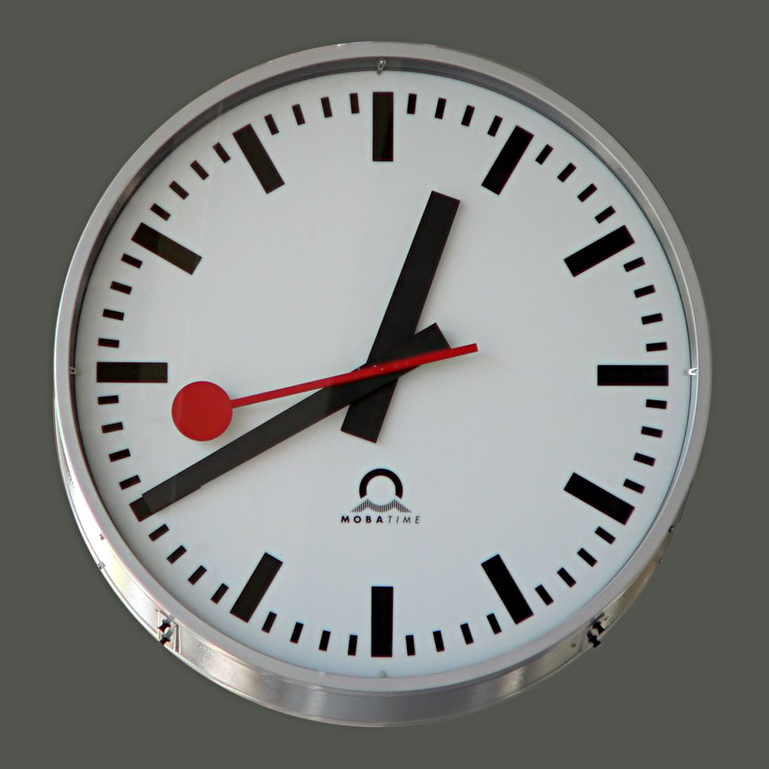
Attitude to time
How flexible is your approach to time?
Do you prefer to be on time every time, or do you feel comfortable with a changing schedule?
Do you schedule following a linear time by the clock or calendar, or do you schedule by what needs to be done?
Which one is more important to you, starting and completing something on time, or completing it in whatever time is needed?

Slide 6
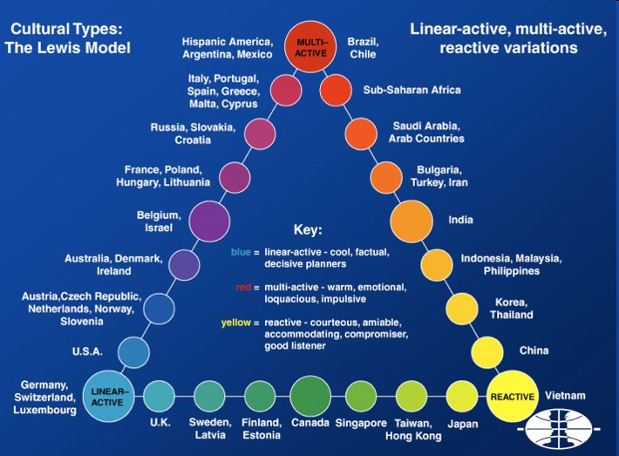

Slide 7

SOME THOUGHTS FOR THE FUTURE TEAMWORK...
“A beautiful song cannot be composed only with one tune,
a beautiful painting cannot be painted only with one color,
a delicious meal cannot be prepared only with one ingredient,
identical things cannot lead to diversity”
Chinese proverb

